Slide 1
Restaurant Location Selection in New York City
By Dominic Fiorentino

Slide 2
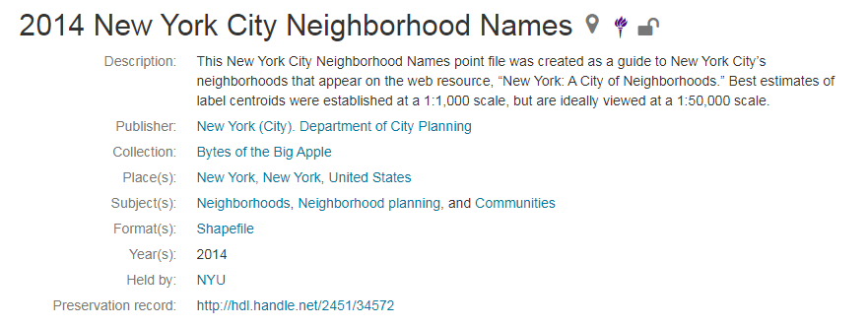
Utilizing NYU New York City Data Set

Slide 3
Utilizing Foursquare API for searching Venues
Via https://foursquare.com/

Slide 4
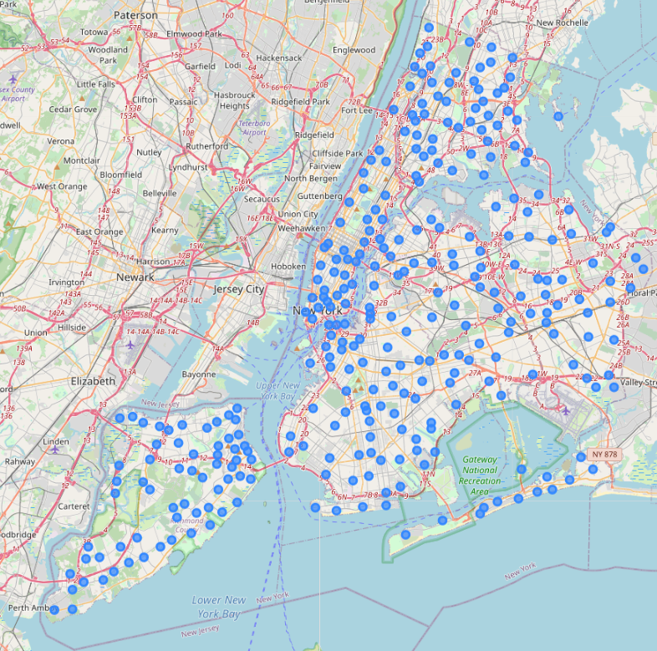
Map of the Neighborhoods of New York City
Each Dot represents a centroid of the corresponding Neighborhood

Slide 5
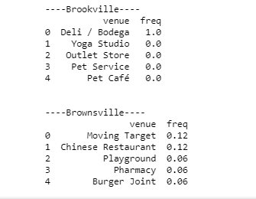
Example of the top 5 common venues of each Neighborhood

Slide 6
Top ten Most Common Venues in every Neighborhood in New York City

Slide 7
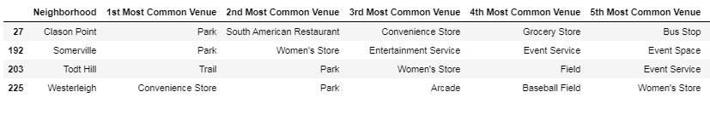
Clustering Neighborhoods

Slide 8
Potential Location
The potential location identified through data analysis and clustering identified Brookville, NY as a desired location for a new restaurant.
Cluster number 5 revealed Brookville New York as a location with limited food options
Cluster number 5 also revealed several locations for catering opportunities

Slide 9
Rationale for selection of Brookville, NY for XYZ Hospitality Company
Only having 2 out of ten common venues being food
Increased revenue opportunities of partnering with the event and exhibit spaces for catering of events
The proximity to farms which is listed as the 10th most common venue allows for an increased potential savings on food while also being able to advertise as local farm to table restaurant in New York City.

Slide 10
References
https://foursquare.com/
https://www.coursera.org/
https://geo.nyu.edu/catalog/nyu_2451_34572

